Slide 1
K-Nearest Neighbor Classifiers (KNNC)
J.-S. Roger Jang (張智星)
jang@mirlab.org
http://mirlab.org/jang
MIR Lab, CSIE Dept.
National Taiwan University

Slide 2
Concept of KNNC
Concept: 近朱者赤、近墨者黑
Two Steps:
Find the first k nearest neighbors of a given point.
Determine the class of the given point by voting among k nearest neighbors.
Quiz!
: class-A point
: class-B point
: point with unknown class
Feature 2
3 nearest neighbors
➔ The point is classified as B via 3NNC.
Feature 1

Slide 3
Flowchart for KNNC
General flowchart of PR:
KNNC:
Feature
extraction
From raw data to features
Model
construction
Clustering (optional)
Model
evaluation
KNNC evaluation
on test dataset

Slide 4
Decision Boundary for 1NNC
Voronoi diagram: piecewise linear boundary
Quiz!
More about Voronoi diagrams

Slide 5
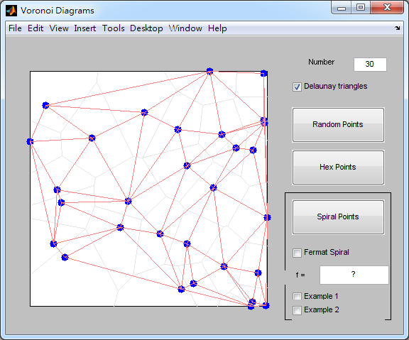
Demos by Cleve Moler
Cleve’s Demos of Delaunay triangles and Voronoi diagram
books/dcpr/example/cleve/vshow.m

Slide 6

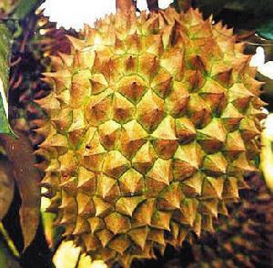
Natural Examples of Voronoi Diagrams (1/2)

Slide 7
Characteristics of KNNC
Strengths of KNNC
Intuitive
No computation for model construction
Weakness of KNNC
Massive computation required when dataset is big
No straightforward way
To determine the value of K
To rescale the dataset along each dimension
Quiz!

Slide 8
Preprocessing of Feature Normalization
Z normalization or z score
To have zero mean and unit variance along each feature
Min-max normalization
To have a specific range, such as [0, 1], along each feature
Quiz!

Slide 9
Variants for KNNC
Many variants of KNNC:
Nearest prototype classification
Single prototype for each class ➔ Use “mean” or “average”
Several prototypes for each class ➔ Use “k-means clustering”
Distance-weighted votes
Edited nearest neighbor classification
k+k-nearest neighbor
Quiz!

Slide 10
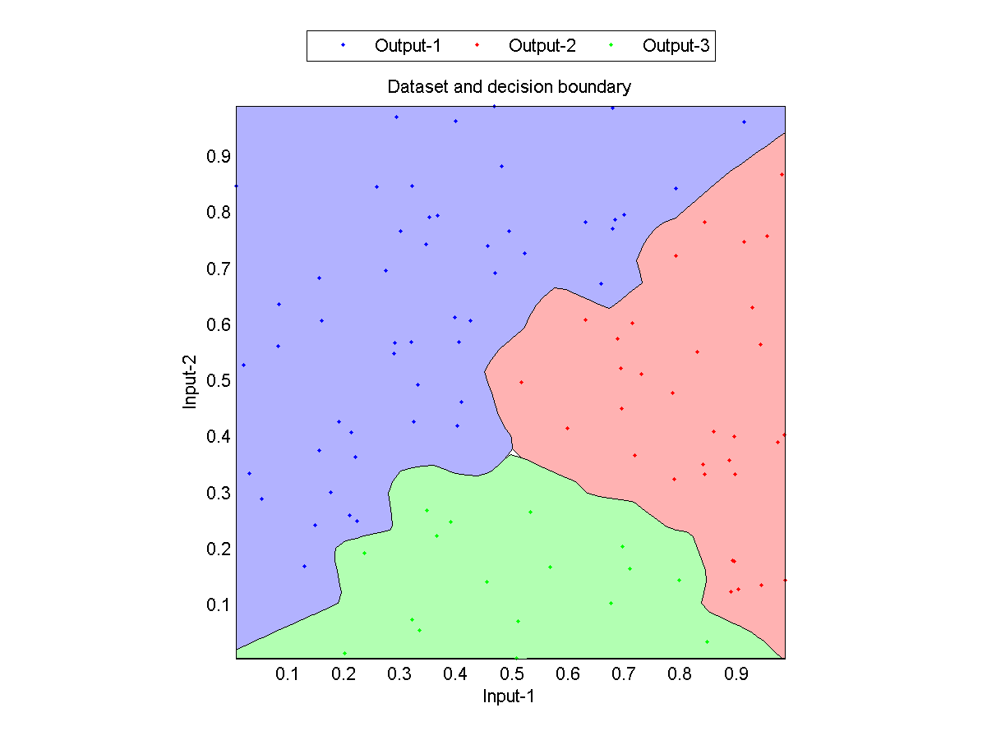
1NNC Decision Boundaries
1NNC Decision boundaries

Slide 11
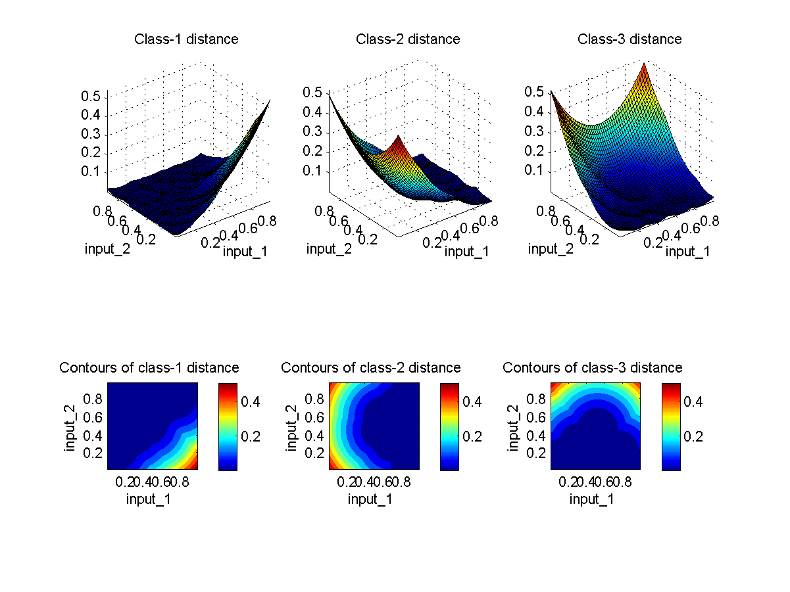
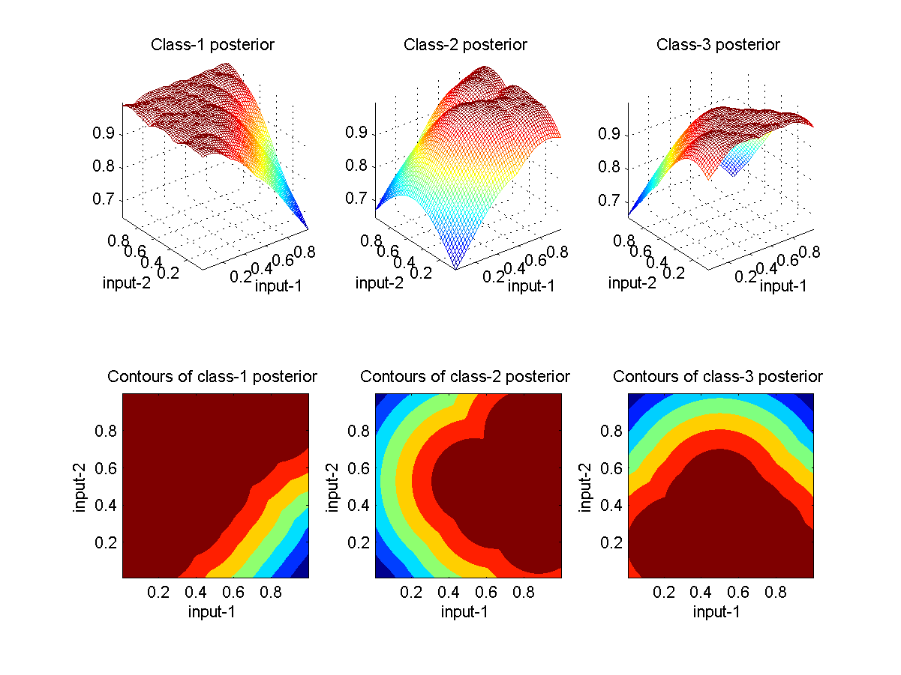
1NNC Distance/Posterior as Surfaces and Contours

Slide 12
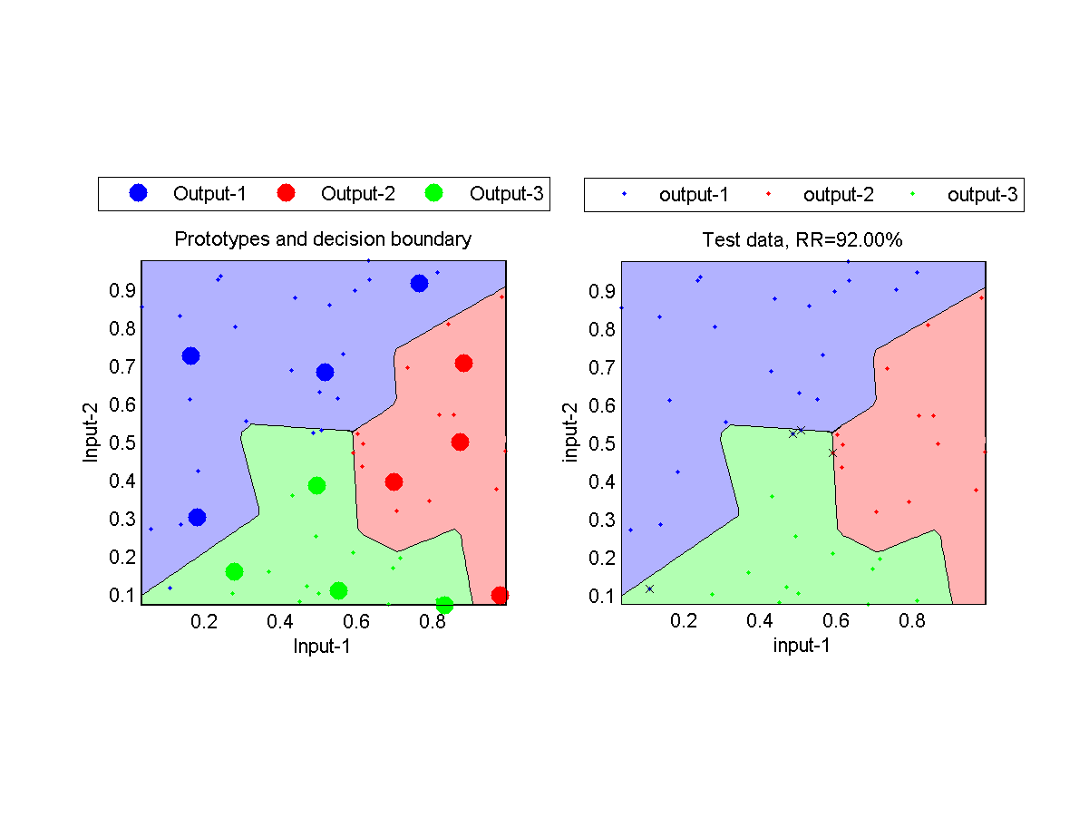
Using Prototypes in KNNC
No. of prototypes for each class is 4.

Slide 13
Decision Boundaries of Different Classifiers
Naive Bayes classifier
Quadratic classifier
1NNC classifier

Slide 14
Maximum Likelihood Estimate
Jyh-Shing Roger Jang (張智星)
CSIE Dept, National Taiwan University

Slide 15
Intro. to Maximum Likelihood Estimate
MLE
Maximum likelihood estimate
Goal:
Given a dataset with no labels, how can we find the best statistical model with the optimum parameters to describe the data?
Applications
Prediction
Analysis

Slide 16

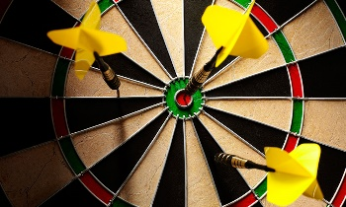
What Are Statistical Models?
Statistical models are used to describe the probabilities of random variables
Discrete variables ➔ Probability functions
Continuous variables ➔ Probability density functions (PDF)
Examples
Discrete variables
The outcome of tossing a coin or a die
Continuous variables
The distance to the bull eye when throwing a dart
The time needed to run 100-m dash
The heights of second-grade students
Personalized PDF!

Slide 17
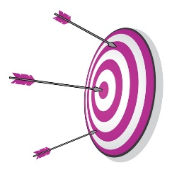
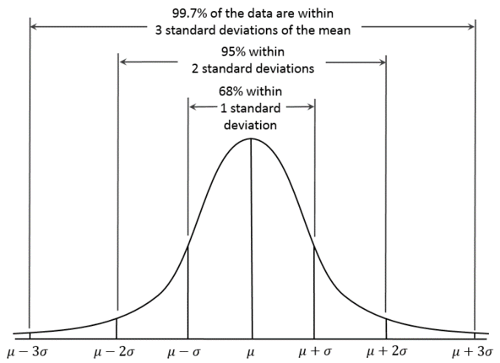
More about Models
Discrete variables
Outcome of tossing a coin ➔ Pr{head}=1/2, Pr{tail}=1/2
Continuous variables
Distance to the bull’s eye when throwing a dart ➔ A PDF of Gaussian or normal distribution
Quiz!
Probability of x in [4, 6]

Slide 18
Basic Steps in MLE
Steps
Perform a certain experiment to collect the data.
Choose a parametric model of the data, with certain modifiable parameters.
Formulate the likelihood as an objective function to be maximized.
Maximize the objective function and derive the parameters of the model.
Examples
Flip a coin ➔ To find the probabilities of head and tail
Throw a dart ➔ To find your PDF of distance to the bull eye

Slide 19
Probability Functions for Discrete Variables
Flip an unfair coin 5 times to get 3 heads and 2 tails
By intuition: Pr{head}=3/5, Pr{tail}=2/5
By MLE
Assume these 5 tosses are independent events to have the overall probability

Slide 20
Inequality of Arithmetic and Geometric Means
AM-GM inequality
Proof of this inequality
Wikipedia
How to use the inequality to solve MLE problem?
Quiz!

Slide 21
How to Prove AM-GM Inequality?
How to prove it?
Jensen’s inequality
Proof by induction

Slide 22
Proof by Induction

Slide 23
Probability Functions for Discrete Variables
Toss a 3-side die for many times and obtain n₁ of side 1, n₂ of side 2, and n₃ of side 3, then what is the most likely probabilities for sides 1, 2, and 3, respectively?
Our intuition…
By MLE…
Quiz!

Slide 24
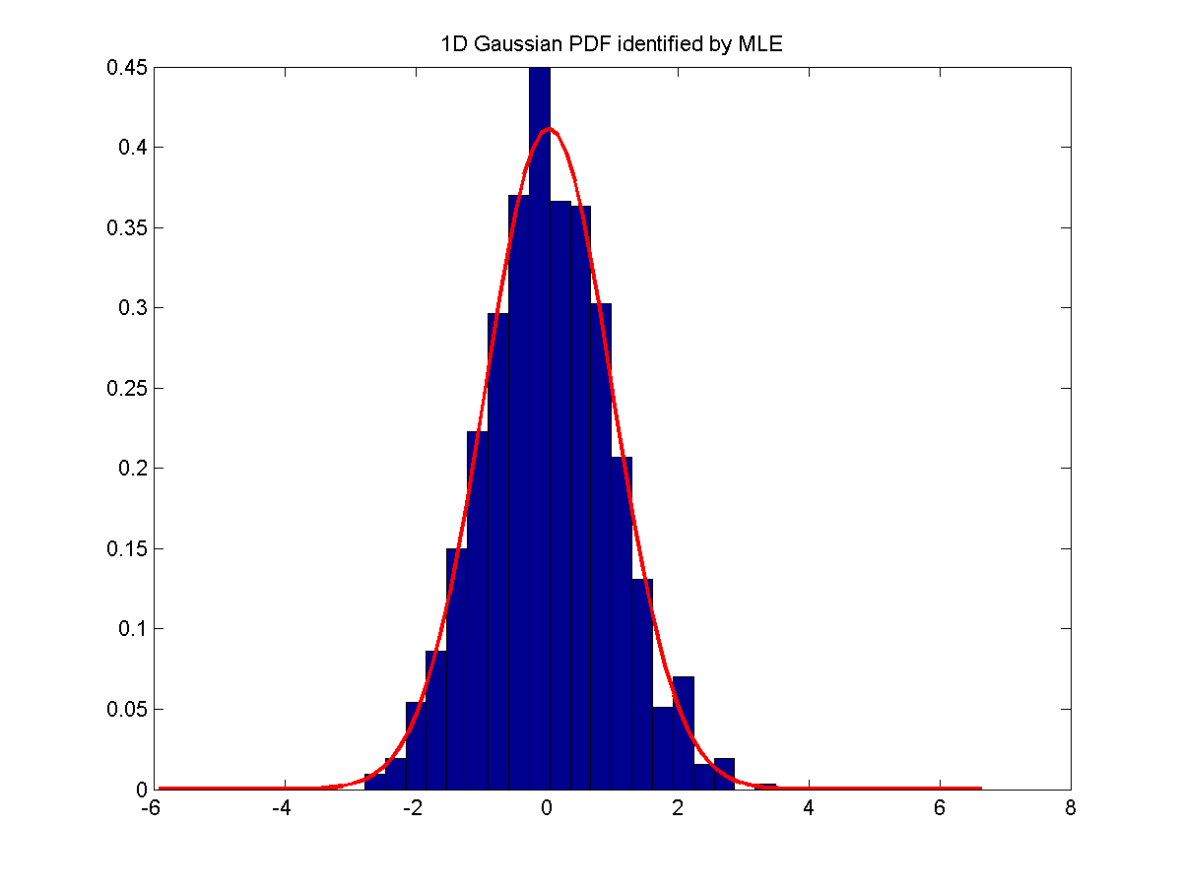
MLE for PDF of Continuous Variables of 1D
Detailed coverage
PDF
Overall PDF,
or likelihood
Log likelihood
MLE!
Quiz!

Slide 25
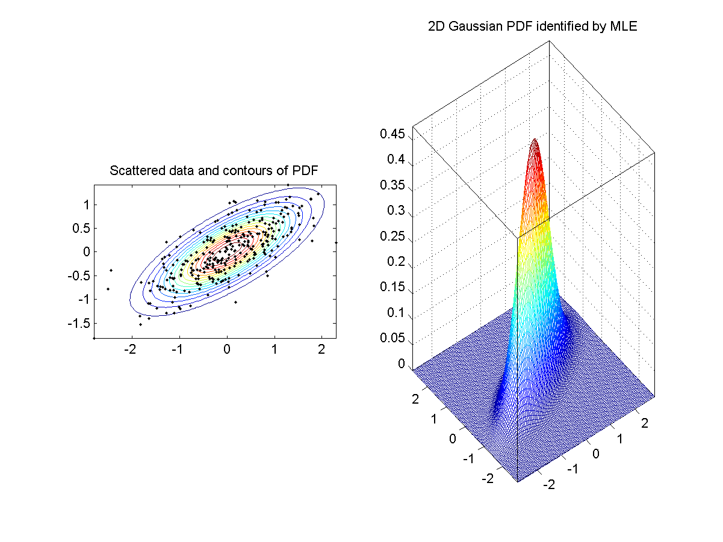
MLE for PDF of Continuous Variables of ND
Detailed coverage
PDF
Overall PDF,
or likelihood
Log likelihood
MLE!

Slide 26
Q & A
Questions
Can we choose other PDFs instead of Gaussian/normal distributions? ➔ Yes!
What are the other available PDFs?
How do I know the selected PDF is appropriate?

Slide 27
Quadratic Classifiers (QC)
J.-S. Roger Jang (張智星)
jang@mirlab.org
http://mirlab.org/jang
MIR Lab, CSIE Dept.
National Taiwan University

Slide 28
Review: PDF Modeling
Goal:
Find a PDF (probability density function) that can best describe a given dataset
Steps:
Select a class of parameterized PDF
Identify the parameters via MLE (maximum likelihood estimate) based on a given set of sample data
Commonly used PDFs:
Multi-dimensional Gaussian PDF
Gaussian mixture models (GMM)

Slide 29
PDF Modeling for Classification
Procedure for classification based on PDF
Training stage: PDF modeling of each class based on the training dataset
Test stage: For each entry in the test dataset, pick the class with the max. PDF
Commonly used classifiers:
Quadratic classifiers, with n-dim. Gaussian PDF
Gaussian-mixture-model classifier, with GMM PDF

Slide 30
1D Gaussian PDF Modeling
1D Gaussian PDF:
MLE of μ (mean) and σ² (variance)

Slide 31
D-dim. Gaussian PDF Modeling
D-dim Gaussian PDF:
MLE of μ (mean) and Σ (covariance matrix)

Slide 32
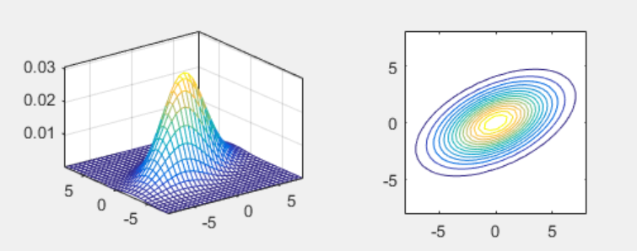
2D Gaussian PDF
Bivariate normal distribution:
PDF
Contours

Slide 33
Training and Test Stages of QC
Quiz!
Training stage
Identify the Gaussian PDF of each class via MLE
Test stage
Assign a sample point to the class C by taking class prior into consideration:
Prior!

Slide 34
Characteristics of QC
If each class is modeled by a Gaussian PDF, the decision boundary between any two classes is a quadratic curve.
That is why it is called quadratic classifier.
How to prove it?
Quiz!

Slide 35
QC on Gender Dataset (1/2)
Scatter plot of Gender dataset
ds=prData('gender');
figure; dsScatterPlot(ds);
Notes:
ds=prData('gender');
figure; dsScatterPlot(ds);

Slide 36
QC on Gender Dataset (2/2)
PDF for each class
Decision boundary
ds=prData('gender');
[qcPrm, logLike, recogRate, hitIndex]=qcTrain(ds);
figure; qcPlot(ds, qcPrm, '2dPdf');
figure; qcPlot(ds, qcPrm, 'decBoundary');
Notes:
ds=prData('gender');
[qcPrm, logLike, recogRate, hitIndex]=qcTrain(ds);
figure; qcPlot(ds, qcPrm, '2dPdf');
figure; qcPlot(ds, qcPrm, 'decBoundary');

Slide 37
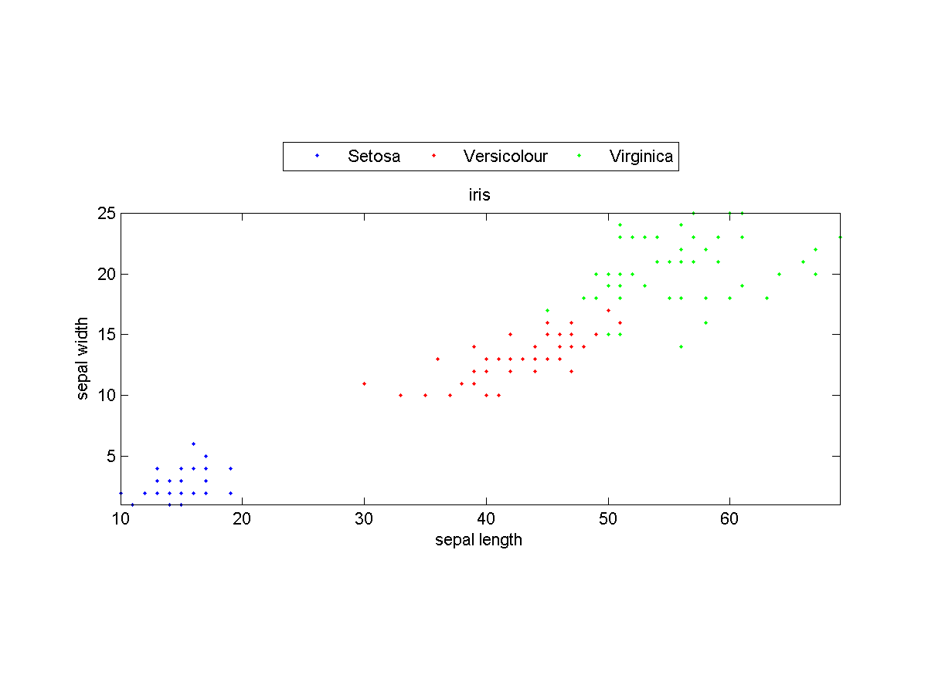
QC on Iris Dataset (1/2)
Scatter plot of Iris dataset (with only the last two dim.)
ds=prData('iris');
ds.input=ds.input(3:4, :);
figure; dsScatterPlot(ds);
Notes:
ds=prData('iris');
ds.input=ds.input(3:4, :);
figure; dsScatterPlot(ds);

Slide 38
QC on Iris Dataset (2/2)
PDF for each class
Dec. boundaries
ds=prData('iris');
ds.input=ds.input(3:4, :);
[qcPrm, logLike, recogRate, hitIndex]=qcTrain(ds);
figure; qcPlot(ds, qcPrm, '2dPdf');
ds.hitIndex=hitIndex; % For plotting
figure; qcPlot(ds, qcPrm, 'decBoundary');
Notes:
ds=prData('iris');
ds.input=ds.input(3:4, :);
[qcPrm, logLike, recogRate, hitIndex]=qcTrain(ds);
figure; qcPlot(ds, qcPrm, '2dPdf');
ds.hitIndex=hitIndex; % Attach hitIndex to DS for plotting
figure; qcPlot(ds, qcPrm, 'decBoundary');

Slide 39
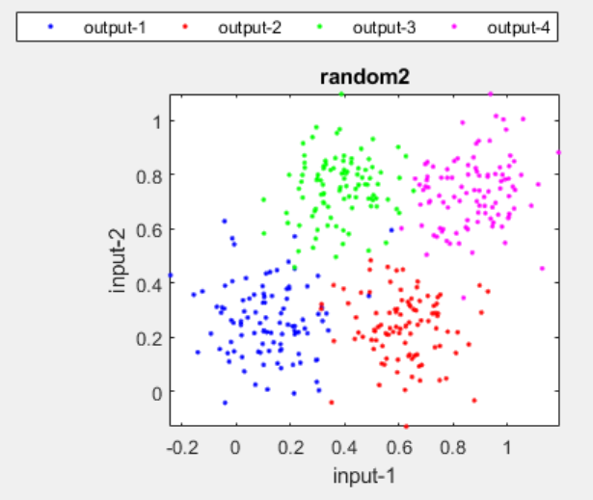
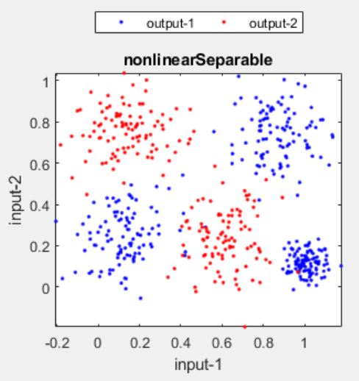
Strength and Weakness of QC
Quiz!
Strength
Easy computation when the dimension d is small
Efficient way to compute leave-one-out cross validation
Weakness
The covariance matrix (d by d) is big when the dimension d is median large
The inverse of the covariance matrix may not exist
Cannot handle bi-modal data correctly
Uni-modal!
Multi-modal!

Slide 40
Modified Versions of QC
Quiz!
How to modify QC such that it won’t deal with a big covariance matrix?
Make the covariance matrix diagonal ➔ Equivalent to naïve Bayes classifiers (proof?)
Make the covariance matrix a constant times an identity matrix
gaussianMle;

Slide 41
Naive Bayes Classifiers (NBC)
J.-S. Roger Jang (張智星)
jang@mirlab.org
http://mirlab.org/jang
MIR Lab, CSIE Dept.
National Taiwan University

Slide 42
Assumptions & Characteristics
Assumptions:
Statistical independency between features
Statistical independency between samples
Each feature governed by a feature-wise parameterized PDF (usually a 1D Gaussian)
Characteristics
Simple and easy (That’s why it’s named “naive”.)
Highly successful in real-world applications regardless of the strong assumptions

Slide 43
Training and Test Stages of NBC
Quiz!
Training stage
Identify class PDF, as follows.
Identify feature PDF by MLE for 1D Gaussians
Class PDF is the product of all the corresponding feature PDFs
Test stage
Assign a sample to the class by taking class prior into consideration:

Slide 44
NBC for Gender Dataset (1/2)
Scatter plot of Gender dataset
PDF on each features and each class
ds=prData('gender');
figure; dsScatterPlot(ds);
[nbcPrm, logLike, recogRate, hitIndex]=nbcTrain(ds);
figure; nbcPlot(ds, nbcPrm, '1dPdf');
Notes:
ds=prData('gender');
figure; dsScatterPlot(ds);
[nbcPrm, logLike, recogRate, hitIndex]=nbcTrain(ds);
figure; nbcPlot(ds, nbcPrm, '1dPdf');

Slide 45
NBC for Gender Dataset (2/2)
PDF for each class
Decision boundary
ds=prData('gender');
[nbcPrm, logLike, recogRate, hitIndex]=nbcTrain(ds);
figure; nbcPlot(ds, nbcPrm, '2dPdf');
figure; nbcPlot(ds, nbcPrm, 'decBoundary');
Notes:
ds=prData('gender');
[nbcPrm, logLike, recogRate, hitIndex]=nbcTrain(ds);
figure; nbcPlot(ds, nbcPrm, '2dPdf');
figure; nbcPlot(ds, nbcPrm, 'decBoundary');

Slide 46
NBC for Iris Dataset (1/2)
Scatter plot of Iris dataset (with only the last two dim.)
PDF on each features and each class
ds=prData('iris');
ds.input=ds.input(3:4, :);
figure; dsScatterPlot(ds);
[nbcPrm, logLike, recogRate, hitIndex]=nbcTrain(ds);
figure; nbcPlot(ds, nbcPrm, '1dPdf');
Notes:
ds=prData('iris');
ds.input=ds.input(3:4, :);
figure; dsScatterPlot(ds);
[nbcPrm, logLike, recogRate, hitIndex]=nbcTrain(ds);
figure; nbcPlot(ds, nbcPrm, '1dPdf');

Slide 47
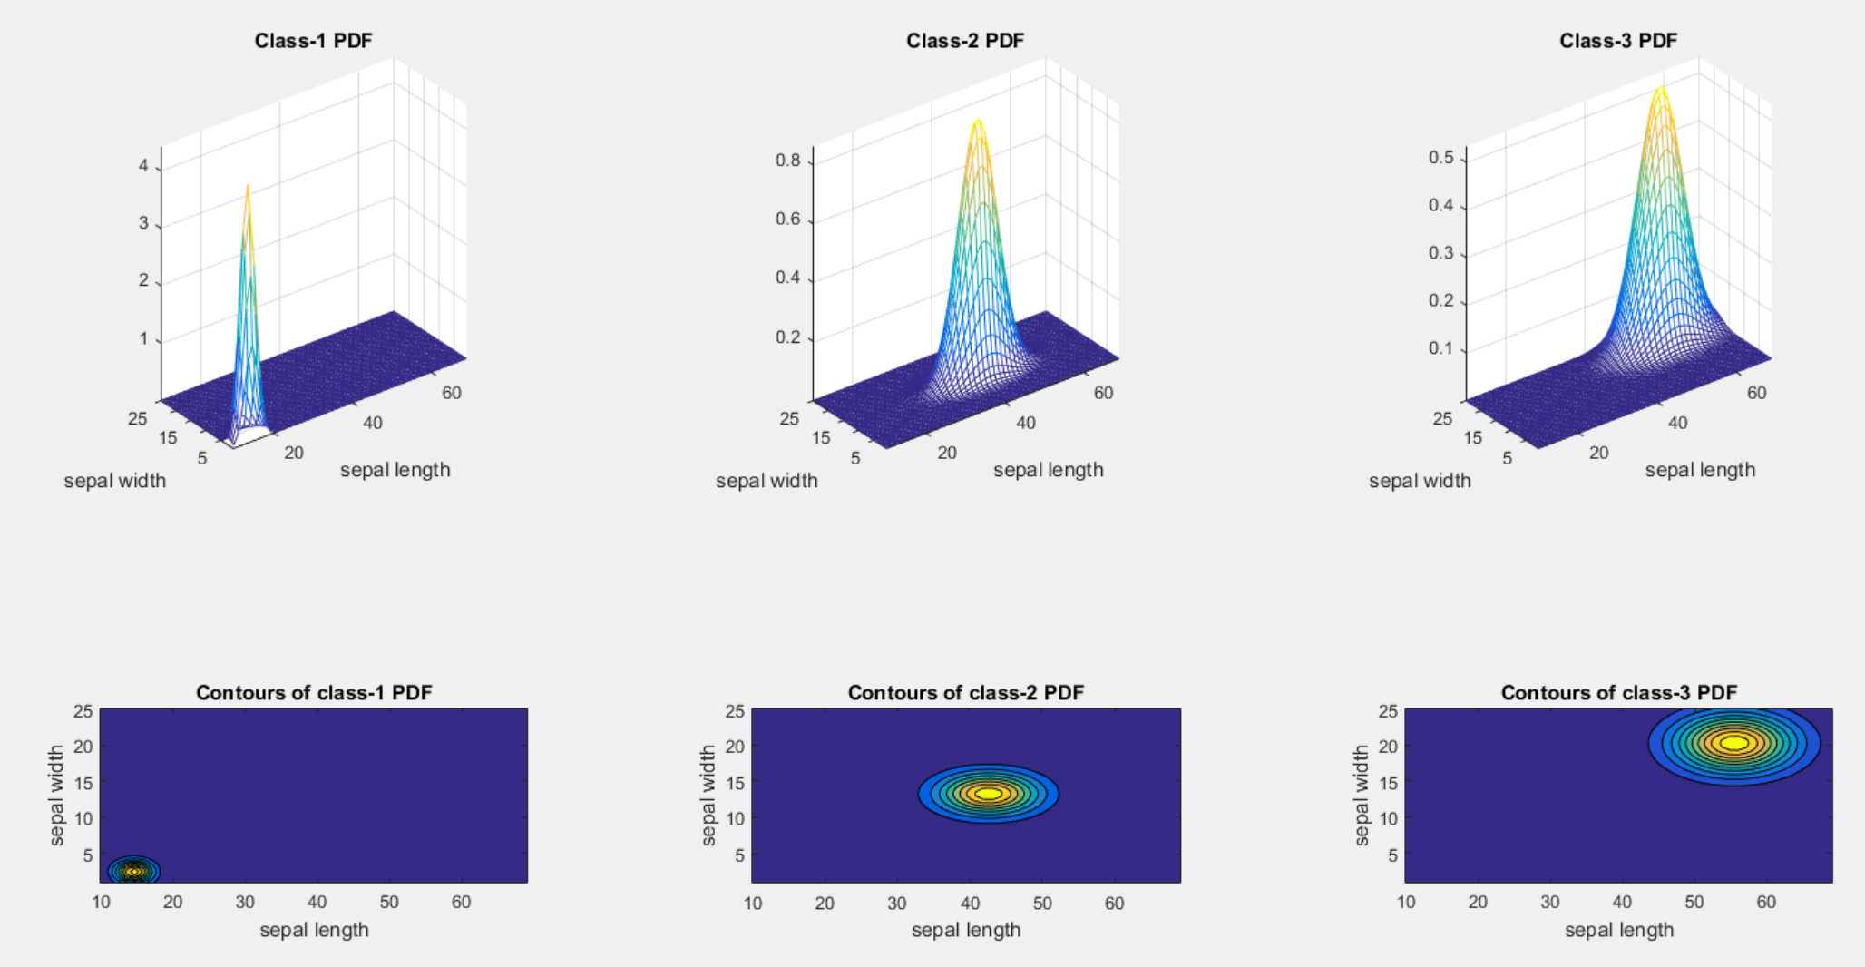
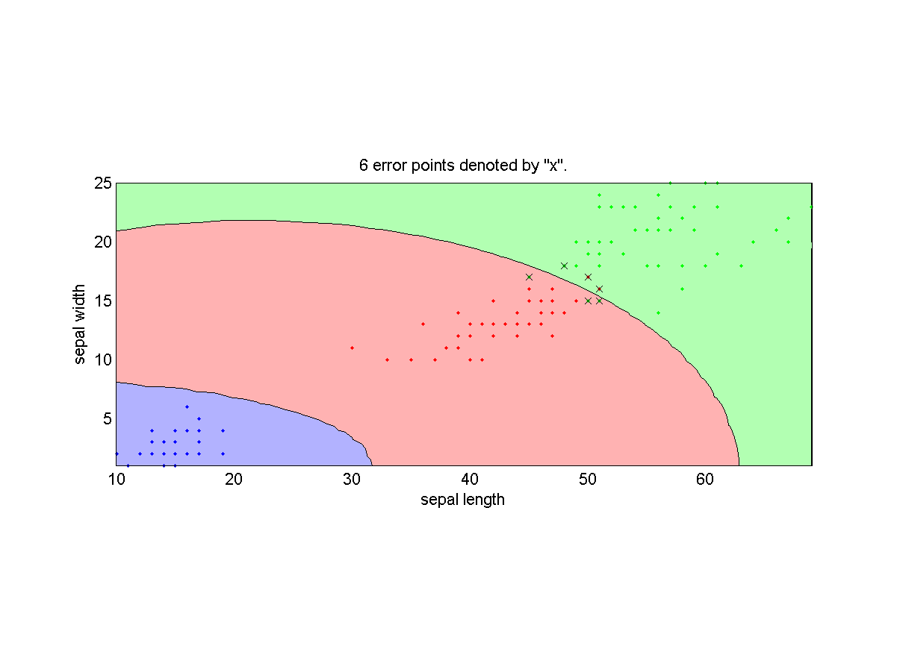
NBC for Iris Dataset (2/2)
PDF for each class
Dec. boundaries
ds=prData('iris');
ds.input=ds.input(3:4, :);
[nbcPrm, logLike, recogRate, hitIndex]=nbcTrain(ds);
figure; nbcPlot(ds, nbcPrm, '2dPdf');
ds.hitIndex=hitIndex; % For plotting
figure; nbcPlot(ds, nbcPrm, 'decBoundary');
Notes:
ds=prData('iris');
ds.input=ds.input(3:4, :);
[nbcPrm, logLike, recogRate, hitIndex]=nbcTrain(ds);
figure; nbcPlot(ds, nbcPrm, '2dPdf');

Slide 48
Strength and Weakness of NBC
Quiz!
Strength
Fast computation during training and evaluation
Robust than QC
Weakness
No able to deal with bi-modal data correctly
Class boundary not as complex as QC

Slide 49
Quiz
Quiz!
KNNC
Two Steps:
Find the first k nearest neighbors of a given point.
Determine the class of the given point by voting among k nearest neighbors.
Strengths of KNNC
Intuitive
No computation for model construction
Weakness of KNNC
Massive computation required when dataset is big
No straightforward way
To determine the value of K
To rescale the dataset along each dimension
Nearest prototype classification
Single prototype for each class ➔ Use “mean” or “average”
Several prototypes for each class ➔ Use “k-means clustering”

Slide 50
Quiz
Quiz!
Continuous variables
Distance to the bull’s eye when throwing a dart ➔ A PDF of Gaussian or normal distribution
AM-GM inequality
Probability Functions for Discrete Variables
Detailed coverage

